Slide 1
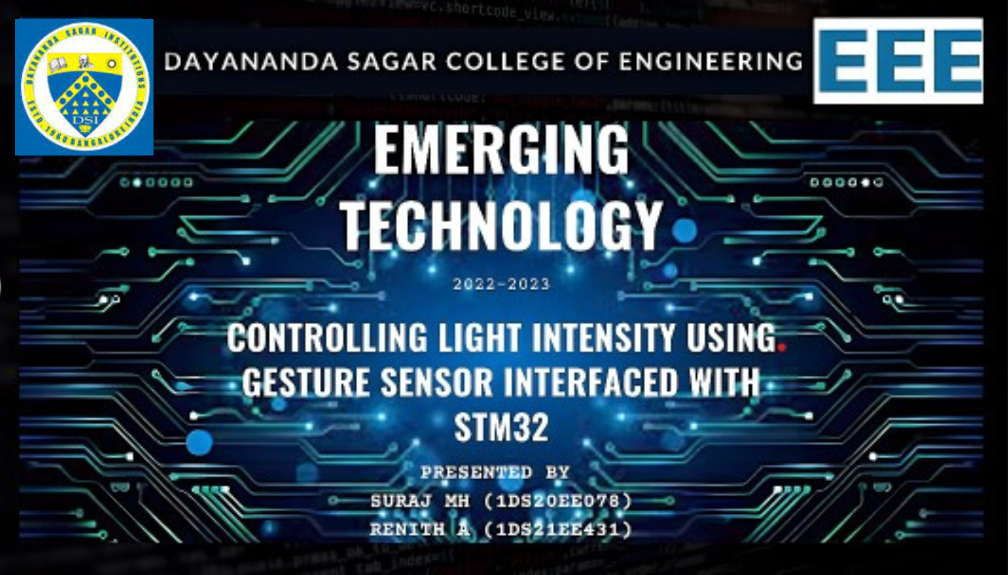

Slide 2
Components required
STM32 F103C8T6 {BLUE PILL}
GESTURE SENSOR - APDS 9960
OLED DISPLAY – SSD1306
STEPDOWN TRANSFORMER {220 V AC to 12 V AC}
TRIAC – BT136
OPTOCOUPLER - MCT6 & MOC 3021
RESISTORS
LED
TESTLAMP
CONNECTING WIRES
PERF BOARD

Slide 3
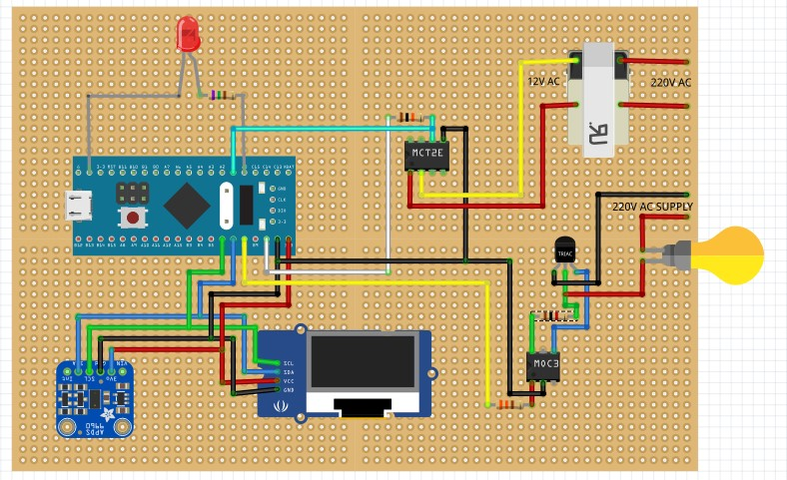
CIRCUIT DIAGRAM

Slide 4
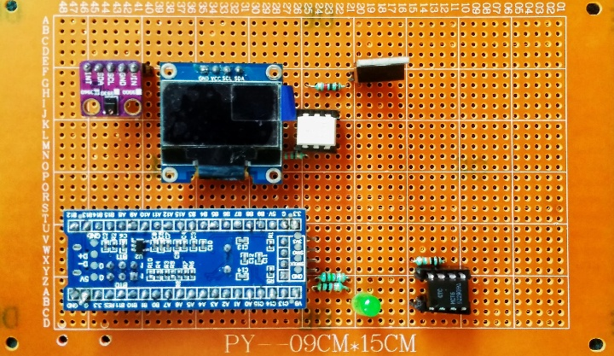
frontside view of the perf board

Slide 5
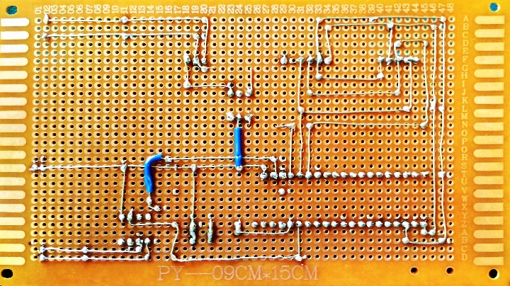
Backside view of the perf board

Slide 6
WORKING OF LED CIRCUIT
For this part we require only the gesture control circuit and an led pin connected to the PWM pin of STM32 board.
Now when we start performing gestures like LEFT , RIGHT , UP, DOWN
the gesture sensor will detect the gestures .
When the gestures are detected ,the stm32 will perform the assigned tasks as defined in the code like for eg., when left gesture is detected it will turn on the led and right gesture will turn off the lamp.
The assigned gestures are
-LEFT = ON
-RIGHT = OFF
-UP = FULL BRIGHTNESS
-DOWN = LEAST BRIGHTNESS

Slide 7
WORKING OF LAMP CIRCUIT
For this part of circuit it requires both gesture control circuit to detect gestures and an power driving circuit to control the test lamp voltage supply.
The power driving circuit consists of triac, optocouplers, resistors, stepdown transformer.
Now when we start performing gestures like LEFT , RIGHT , UP, DOWN
the gesture sensor will detect the gestures .
When the gestures are detected ,the stm32 will perform the assigned tasks as defined in the code like for eg., when left gesture is detected it will turn on the led and right gesture will turn off the led.
The assigned gestures are
-LEFT = ON
-RIGHT = OFF
-UP = OFF
-DOWN = ON

Slide 8
APPLICATIONS
Home automation like controlling light intensity and fan speed by using gestures
Lift
Escalator
Motor drive system
conclusion
Therefore we can conclude that with the help of the gesture sensor APDS 9960
We can control the intensity of the light of the LED & TEST LAMP.

Slide 9


